Slide 1
Financial Inclusion in Africa.
Rwanda, Kenya, Tanzania and Uganda as a Case Study

Slide 2
What is Financial Inclusion?
It is where individuals and businesses have access to useful and affordable financial products and services that meet their needs and are delivered in a responsible and sustainable way.
It is the availability and equality of opportunities to access financial services.
*For the purpose of this project, we will be using Bank Accounts as the indicator of financial inclusion because of the pivotal role that banks play in access to financial services.
Source of data: Zindi

Slide 3
Problem Statement
Financial inclusion remains one of the main obstacles to economic and human development in Africa.
Traditionally access to bank account has been regarded as an indicator of financial inclusion. Despite the proliferation of bank apps in Africa, and the growth of innovative fin-tech solutions, banks still play a vital role in facilitating access to financial services.
Access to bank accounts enable individuals to save and facilitate payments while also helping businesses build up their credit-worthiness and improve their access to other finance services. Therefore, access to bank accounts is an essential contribution to long-term economic growth.

Slide 4
Benefits of Bank Accounts
Savings
Transparency
Accessibility
Safety
Identity

Slide 5
Objectives
The objective of this project is to identify individuals that are not financially inclusive
which individuals are most likely to have or use a bank account.

Slide 6
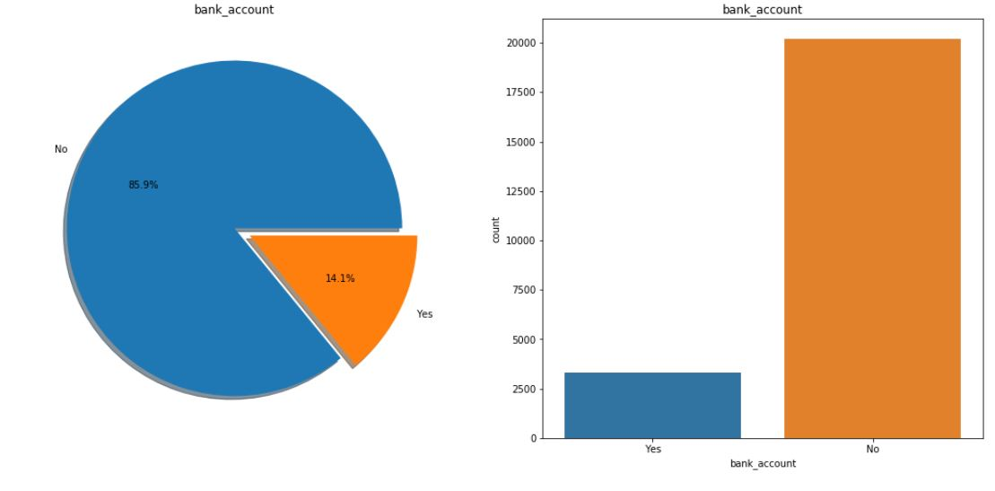
Bank Account owners in all Countries

Slide 7
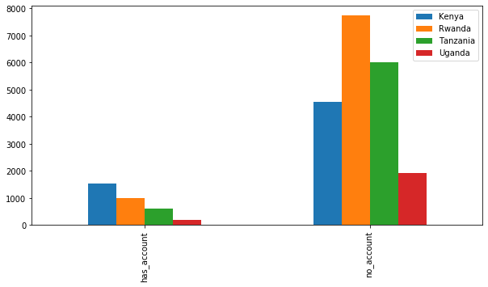
Countries Vs Bank Accounts

Slide 8
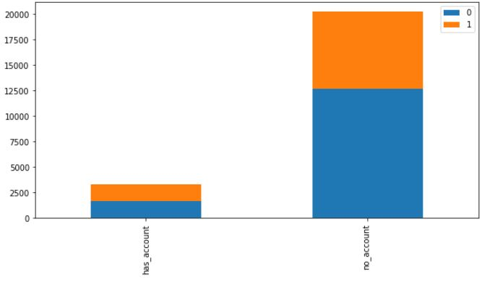
Location Type Vs Bank Account

Slide 9
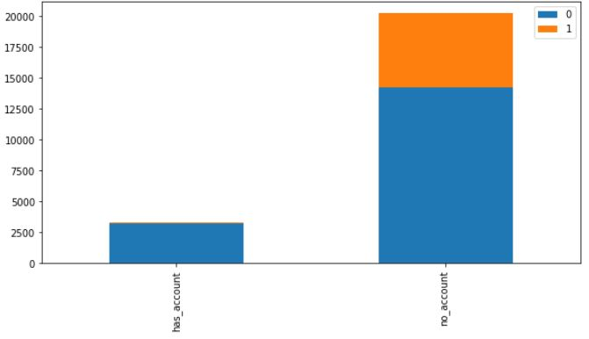
Cell phone Access

Slide 10
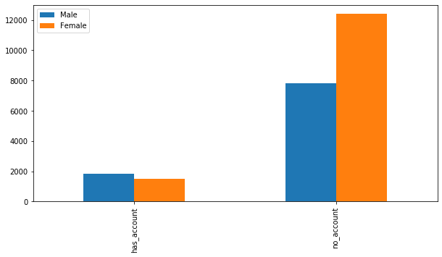
Genders

Slide 11
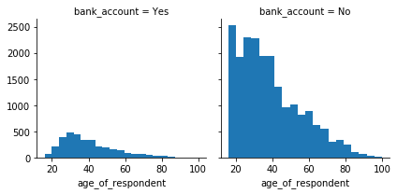
Age Group

Slide 12
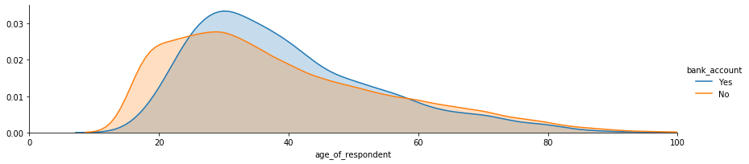

Slide 13
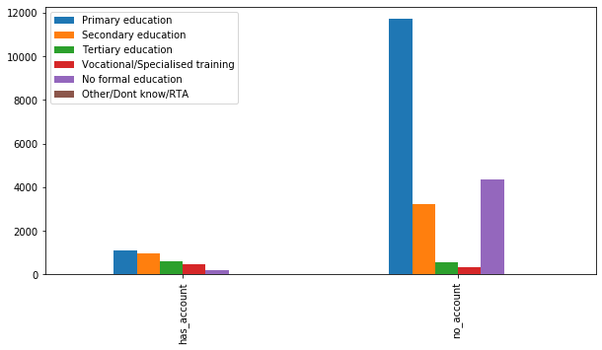
Education Level

Slide 14
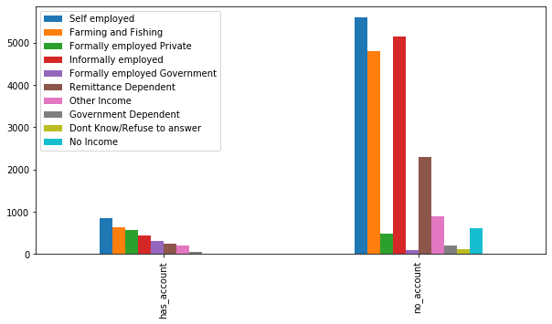
Occupation Level

Slide 15
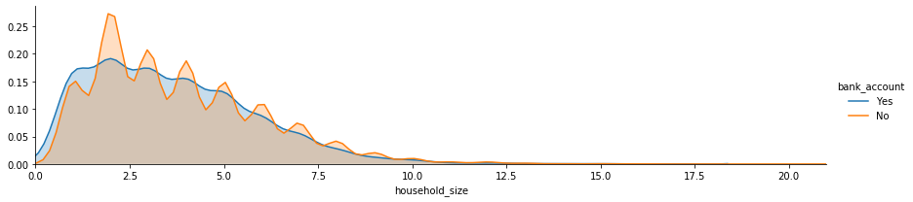
Household Size

Slide 16
Insights
About 85% of the total population do not have a bank account.
Rural areas have a high population of people with no bank account.
A large number of people with no formal education do not have back accounts.
High population of the female gender do not have bank accounts.

Slide 17
Conclusion
Sensitization.
Face education and literacy gaps

Slide 18
Thank you ☺

